Slide 1
Chapter 14 Support Vector Machines
Prof. Lin ZHANG
School of Computer Science and Technology
Tongji University

Slide 2
Outline
Linear separability and hyperplanes
The perceptron learning algorithm
Hard-margin SVM
Soft-margin SVM
Kernelized SVM
Multi-class classification with SVM
Object detection using SVM+HoG

Slide 3
Linear separability
In one dimension, you can find a point separating the data
In two dimensions, you can find a line separating the data
In three dimensions, you can find a plane separating the data

Slide 4
Linear separability
When data is non-linearly separable, we cannot find a separating point, line, or plane.
Non-linearly separable data in 1D
Non-linearly separable data in 2D
Non-linearly separable data in 3D

Slide 5
Linear separability
If data is linearly separable,
for 1D case, we use a point (0D) to separate the data
for 2D case, we use a line (1D) to separate the data
for 3D case, we use a plane (2D) to separate the data
What do we use to separate the data when there are more than three dimensions?
Hyperplane!

Slide 6
Hyperplane
Definition 1: Hyperplane
In geometry, a hyperplane is a subspace of one dimension less than its ambient space
In d-D Euclidean space, a hyperplane is the set of points satisfying,
where is the point locating on that hyperplane, is the hyperplane’s normal vector, and b is a constant
If not so straightforward, make an analogy with the cases of the line in 2D space and the plane in the 3D Euclidean space

Slide 7
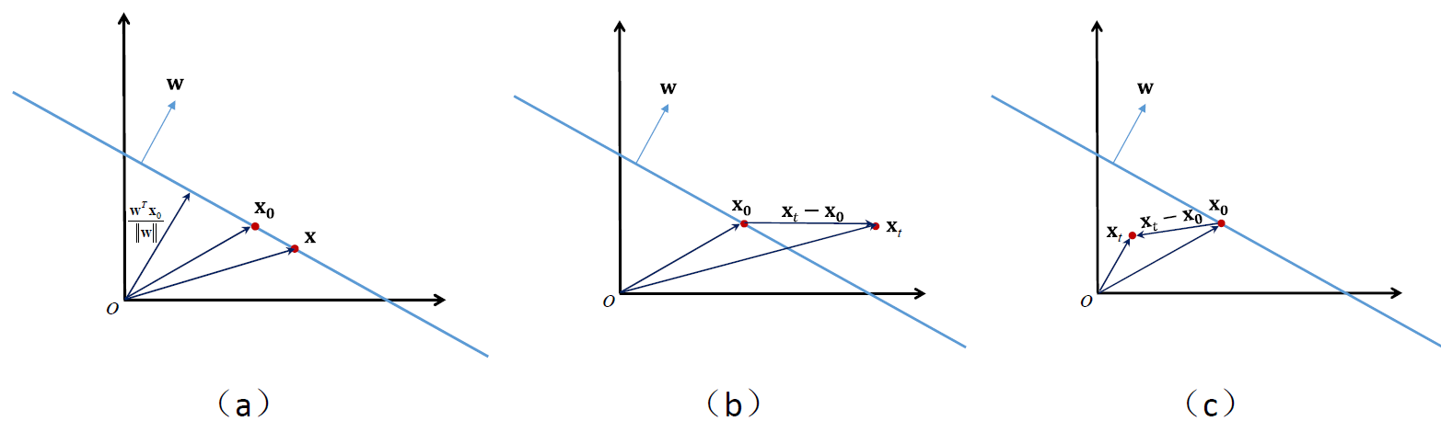
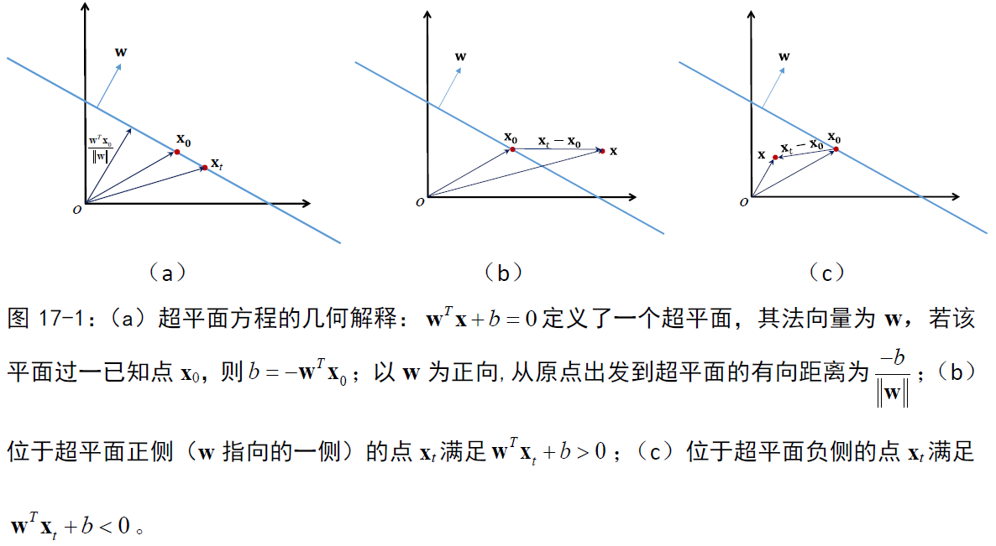
Hyperplane

Slide 8
Classifying data with a hyperplane
Given a set of data points {x_{i}} shown as the right figure and a hyperplane defined by w=(0.4, 1.0)^{T} and b=-9
Suppose the classification model is h_{w,b}:
which is equivalent to :
We can associate each x_{i} with a label +1 or -1
(a linear classifier)
Eg., x=(8,7)
, which is positive, so h_{w,b}(x)=+1
It means x is above the hyperplane.
It uses the position of x with respect to the hyperplane to predict x’s label

Slide 9
Classifying data with a hyperplane
The main questions is, given a set of linearly separable data, how to find such a hyperplane that separates the data points?
Next, we will at first introduce a simple algorithm to perform this task, i.e., perceptron

Slide 10
Outline
Linear separability and hyperplanes
The perceptron learning algorithm
Hard-margin SVM
Soft-margin SVM
Kernelized SVM
Multi-class classification with SVM
Object detection using SVM+HoG

Slide 11
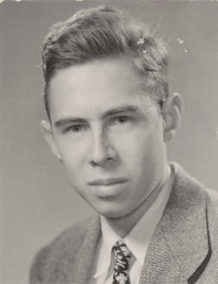
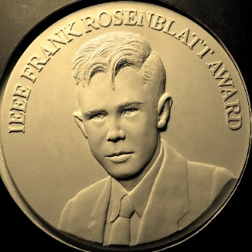
The perceptron learning algorithm
The goal of the perceptron algorithm is to find a hyperplane that can separate a linearly separable data set; once the hyperplane is found, it is used to perform binary classification; thus, it is a linear binary classifier (by extension, such an architecture can also perform multiclass classification)
It was invented by Frank Rosenblatt in 1957^{[1]}
（a） | （b）
弗兰克·罗森布拉特（Frank Rosenblatt，1928年7月11日-1971年7月11日）是美国心理学家，在人工智能领域享有盛誉。1971年，43岁生日那天，他在切萨皮克湾（Chesapeake Bay）驾驶一艘名为Clearwater的单桅帆船时溺水身亡。由于他最早提出了感知器学习算法，而感知器模型现在被认为是神经网络的基础构件，因此也有文献认为他是“深度学习之父”；（b）为了纪念Frank Rosenblatt，IEEE（电气电子工程师学会）从2004年开始设立了IEEE Frank Rosenblatt Award奖，用以表彰对生物和语言驱动的计算范式和系统做出杰出贡献的学者。
[1] Rosenblatt, Frank (1957). "The Perceptron—a perceiving and recognizing automaton". Report 85-460-1. Cornell Aeronautical Laboratory.

Slide 12
The perceptron learning algorithm
The problem the perceptron algorithm wants to solve is,
Given a linearly separable training dataset , determine the hyperplane , ,
Denote and , then
The hyperplane can then be represented by

Slide 13
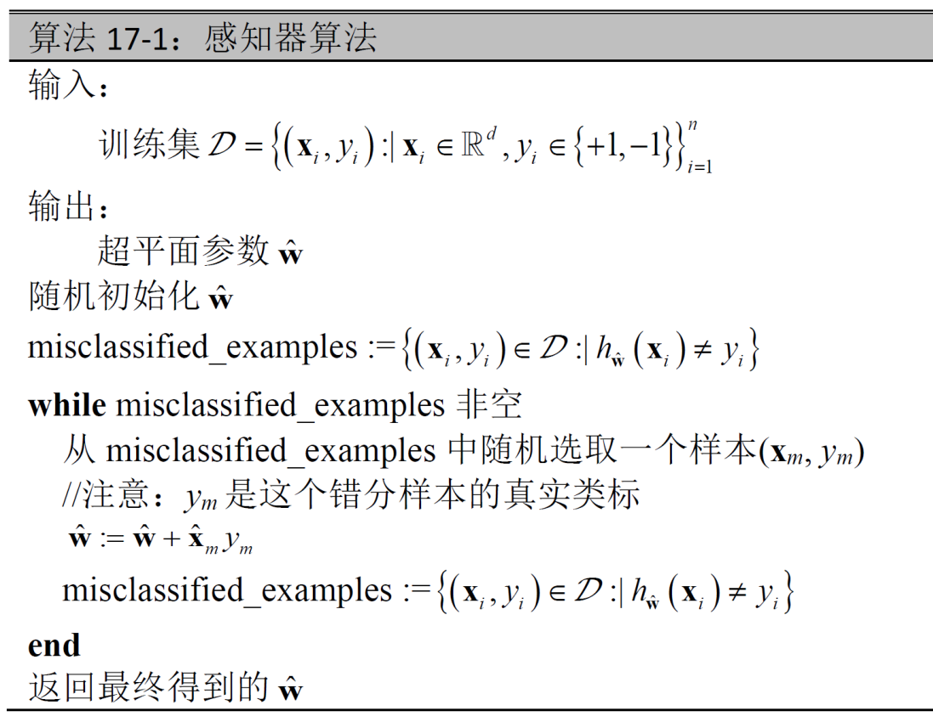
The perceptron learning algorithm
The updating rules for

Slide 14
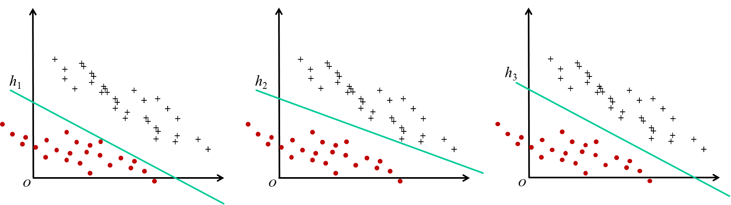
The perceptron learning algorithm
The potential drawbacks of the perceptron learning algorithm
Since the hyperplane is randomly initialized and the misclassified example is randomly selected when updating the parameters, after running this algorithm several times, you may get several different separating hyperplanes
All of these different separating hyperplanes can correctly classify the training data, however, they are not equally good!
Example:
Which hyperplane is the best?

Slide 15
The perceptron learning algorithm
Given a linearly separable dataset, can we get the unique optimal separating hyperplane?
that comes
Hard-margin SVM

Slide 16
弗拉基米尔·瓦普尼克(Vladimir N. Vapnik，1936年12月6日-)，统计学家，因提出了支持向量机、VC 理论等而著名。他出生于前苏联。1958年，他在撒马尔罕（现属乌兹别克斯坦）的乌兹别克国立大学完成了硕士学业。1964年，他于莫斯科控制科学学院获得博士学位。毕业后，他一直在该校工作直到1990年，在此期间，他成为了该校计算机科学与研究系的系主任。1990 年底，弗拉基米尔·瓦普尼克移居美国，加入了位于新泽西州霍姆德尔的At&T贝尔实验室的自适应系统研究部门。1995年，他被伦敦大学聘为计算机与统计科学专业的教授。现在，他工作于新泽西州普林斯顿的NEC实验室。他同时是哥伦比亚大学的特聘教授。2006年，他成为美国国家工程院院士。

Slide 17
Outline
Linear separability and hyperplanes
The perceptron learning algorithm
Hard-margin SVM
Soft-margin SVM
Kernelized SVM
Multi-class classification with SVM
Object detection using SVM+HoG

Slide 18
Redefine the separating hyperplane
For a linearly separable training dataset , we have already know what is the separating hyperplane. If is the separating hyperplane, it must satisfy,
It needs to be noted that, the absolute magnitude of is not important for classification, since,
represent the same hyperplane

Slide 19
Redefine the separating hyperplane
For a separating hyperplane of , we re-parameterize it as
where . Then, for the separating hyperplane , we have,
That is, for any separating hyperplane of , it can be parameterized as (w, b) satisfying,
Definition 2: Separating hyperplane. For a training dataset
a hyperplane h is a separating hyperplane, if and only if it can be represented by (w, b) satisfying,

Slide 20
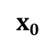
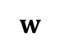
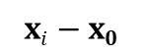
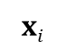
Geometric margin
The geometric margin of a data point with respect to the hyperplane (w, b) can tell us its distance to the hyperplane and can also indicate whether it is correctly classified
$$w$$
The Euclidean distance from x_{i} to the hyperplane,
$$xi$$
d_{i}
$$xi−x0$$
$$x0$$
Based on d_{i}, we can derive the formula of the geometric margin of
Do you notice the difference between the Euclidean distance and the geometric margin (from the data point to the hyperplane)?

Slide 21
Geometric margin
Based on the geometric margins of the points, we can define the geometric margin of a hyperplane
Definition 3: Geometric margin of a hyperplane. For a training dataset , the geometric margin of a hyperplane is,
Why do we think h₃ is the best? It has the largest geometric margin!

Slide 22
Hard-margin Support Vector Machine
For a linearly separable dataset , its optimal separating hyperplane (w*, b*) is the one having the largest geometric margin, i.e.,
where the constraint indicates that the desired hyperplane at first should be a separating hyperplane
The above problem can be reformulated as,

Slide 23
Hard-margin Support Vector Machine
Definition 4: Hard-margin SVM. Suppose that the training dataset is linearly separable. The classification approach identifying the optimal separating hyperplane by solving the following problem is called the hard-margin SVM,
(Eq. 1)
“Hard-margin” means that for every training sample, we require that its geometric margin should be
When we get the optimal separating hyperplane (w*, b*), if the sample (x_{k}, y_{k}) satisfies,
it is the supporting vector for the hyperplane (w*, b*)

Slide 24
Hard-margin Support Vector Machine
Proposition 1: The problem for solving the hard-margin SVM (Eq. 1) is a convex quadratic program problem.
(Eq. 1)
Denote by . Then, ,
Eq. 1 can be reformulated as,
(Eq. 2)
According to Def. 13 in Lecture 9, Eq. 2 is a convex quadratic program problem

Slide 25
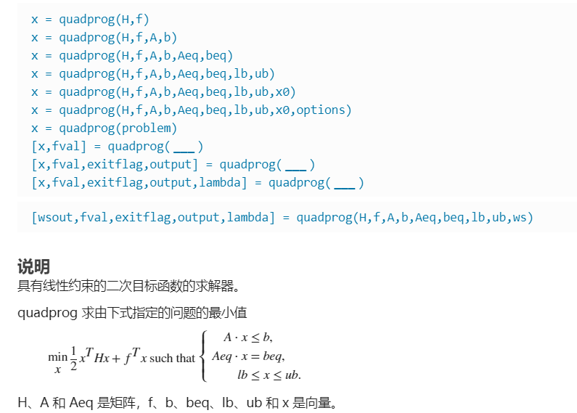
Hard-margin Support Vector Machine
Since the problem of hard-margin SVM is a convex quadratic program problem, it can be solved by using standard packages for solving convex quadratic program problems
Example:
The ‘quadprog’ routine in matlab
By exploring the special characteristics of SVM, more efficient algorithms, based on duality, have been designed

Slide 26
Hard-margin SVM solver based on duality
The primal problem,
(Eq. 1)
Its Lagrangian (Def. 14 of Lecture 9) is,
where
The dual problem (Def. 16 of Lecture 9) of Eq. 1 is,
(Eq. 3)

Slide 27
Hard-margin SVM solver based on duality
is linearly separable
The primal problem of Eq. 1 is a convex optimization problem with all affine constraints
The domain of the objective function is open
The primal problem of Eq. 1 is feasible
Prop. 19 of Lect. 9
The primal problem of Eq. 1 is convex and has strong duality
Prop. 22 of Lect. 9
To solve Eq. 1, we can solve its dual problem Eq. 3 first to get ; then, by using the KKT equations, we derive
and are primal optimal and dual optimal, respectively
and satisfy KKT conditions

Slide 28
Hard-margin SVM solver based on duality
First, solve the dual problem, Eq. 3, to get the dual optimal solution
(1) Compute
(about (w, b), it is a convex function)
Get its stationary point by solving,

Slide 29
Hard-margin SVM solver based on duality
First, solve the dual problem, Eq. 3, to get the dual optimal solution
(2) Solve
(Eq. 4)
(Eq. 5)
Denote by ,
(positive semi-definite)
It is also a convex quadratic program problem!
For solving the specific optimization problem of Eq. 4, algorithms more efficient than standard packages for solving the general convex quadratic program problems exist, such as the sequential minimal optimization, SMO

Slide 30
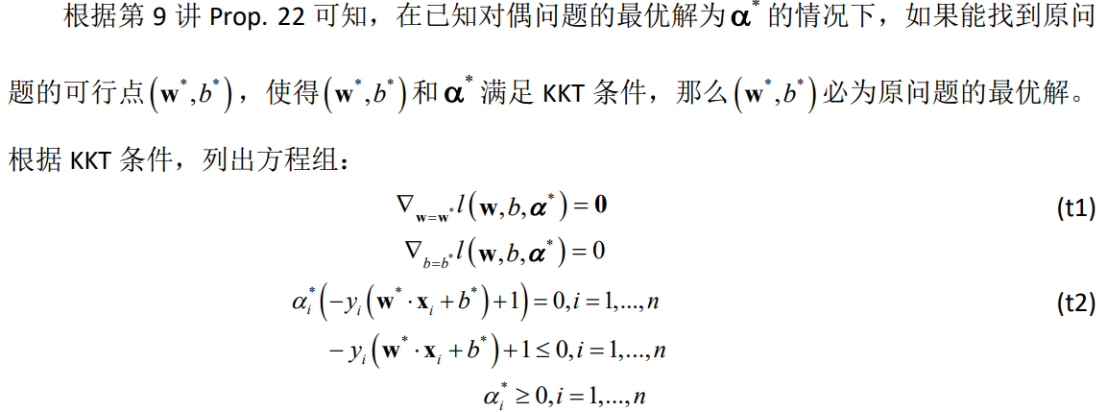
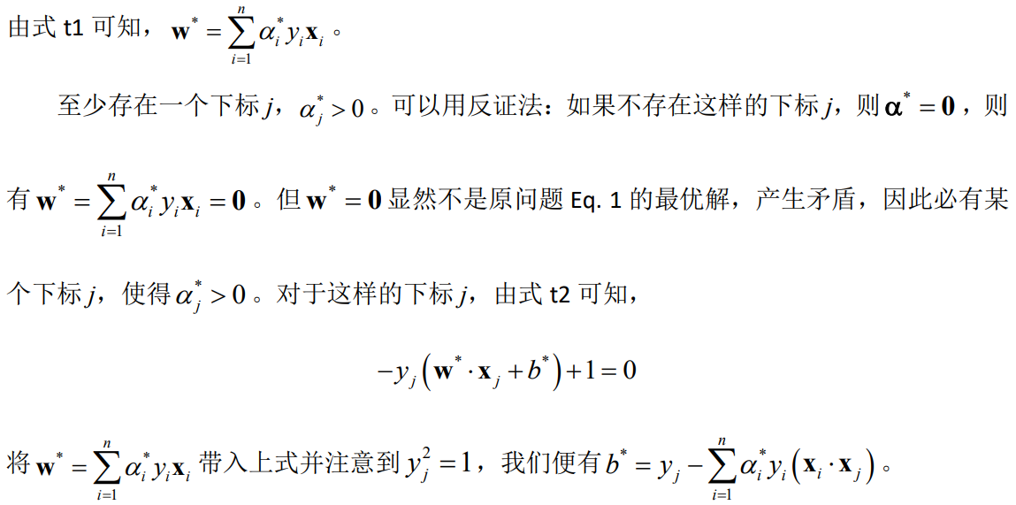
Hard-margin SVM solver based on duality
Second, with , based on KKT conditions, derive the primal optimal solution (w*, b*)
Proposition 2: Suppose that is the optimal solution for Eq. 3. There exists an j, making , and (w*, b*) can be computed as,
(Eq. 6)
(Eq. 7)

Slide 31
Hard-margin SVM solver based on duality
Second, with , based on KKT conditions, derive the primal optimal solution (w*, b*)
Proposition 2: Suppose that is the optimal solution for Eq. 3. There exists an j, making , and (w*, b*) can be computed as,
(Eq. 6)
(Eq. 7)
With the optimal separating hyperplane (w*, b*), the classification decision function can be,
Actually, only a few elements in α* are greater than 0. If , the associated feature vector of the training sample (x_{i}, y_{i}) is a support vector to the hyperplane (w*, b*) since holds

Slide 32
Hard-margin SVM
Example:
h₂
h₁

Slide 33
Outline
Linear separability and hyperplanes
The perceptron learning algorithm
Hard-margin SVM
Soft-margin SVM
Kernelized SVM
Multi-class classification with SVM
Object detection using SVM+HoG

Slide 34
From hard-margin SVM to soft-margin SVM
When the training dataset is linearly separable, the hard-margin SVM can work perfect
However, when the training dataset is not linearly separable, the hard-margin SVM does not work since the separating hyperplane does not exist, i.e., the following optimization problem is not feasible,
(Eq. 1)
How to deal with the dataset that is not linearly separable?
Let’s first consider a relatively simple case

Slide 35
From hard-margin SVM to soft-margin SVM
The training dataset is not linearly separable; however, after removing the outliers, the remaining points are linearly separable
These two points are outliers; by removing them, the dataset would be linearly separable
Can we deal with case by extending the hard-margin SVM?

Slide 36
From hard-margin SVM to soft-margin SVM
The training dataset is not linearly separable; however, after removing the outliers, the remaining points are linearly separable
(Eq. 1)
Relax it to,
For every hyperplane (w, b), for each training sample (x_{i}, y_{i}), making
satisfied. Of course, smaller are preferred, i.e., large need to be penalized
These motivations suggest the following modified SVM model

Slide 37
Soft-margin SVM
Definition 5: Soft-margin SVM. Suppose that the training dataset is nearly linearly separable. The classification approach identifying the optimal separating hyperplane by solving the following problem is called the soft-margin SVM,
(Eq. 8)
By letting C = 0, , the soft-margin SVM model degenerates to the hard-margin one; the soft-margin SVM of course can deal with the case when the training dataset is linearly separable; thus, the soft-margin SVM “includes” the hard-margin SVM, i.e., the hard-margin SVM is a special case of the soft-margin one
The soft-margin SVM is a linear model since its decision boundary is a hyperplane; so, it is also called linear SVM; it can deal with case when the training dataset is nearly linear separable

Slide 38
Soft-margin SVM solver based on duality
Proposition 3: The problem for solving the soft-margin SVM (Eq. 8) is a convex quadratic program problem
For proof, refer to the textbook
Similar as the case of the hard-margin SVM, we can solve the soft-margin SVM using the duality theory

Slide 39
Soft-margin SVM solver based on duality
The primal problem,
(Eq. 8)
Its Lagrangian (Def. 14 of Lecture 9) is,
The dual problem (Def. 14 of Lecture 9) of Eq. 8 is,
(Eq. 9)

Slide 40
Soft-margin SVM solver based on duality
To solve Eq. 8, we can solve its dual problem Eq. 9 first to get ; then, by using the KKT equations, we derive

Slide 41
Soft-margin SVM solver based on duality
First, solve the dual problem, Eq. 9, to get the dual optimal solution
(1) Compute
(about , it is a convex function)
Get its stationary point by solving,

Slide 42
Soft-margin SVM solver based on duality
First, solve the dual problem, Eq. 9, to get the dual optimal solution
(2) Solve
(Eq. 10)
Make a comparison between Eq. 10 and Eq. 4, they are quite similar; Eq. 10 can also be efficiently solved by SMO

Slide 43
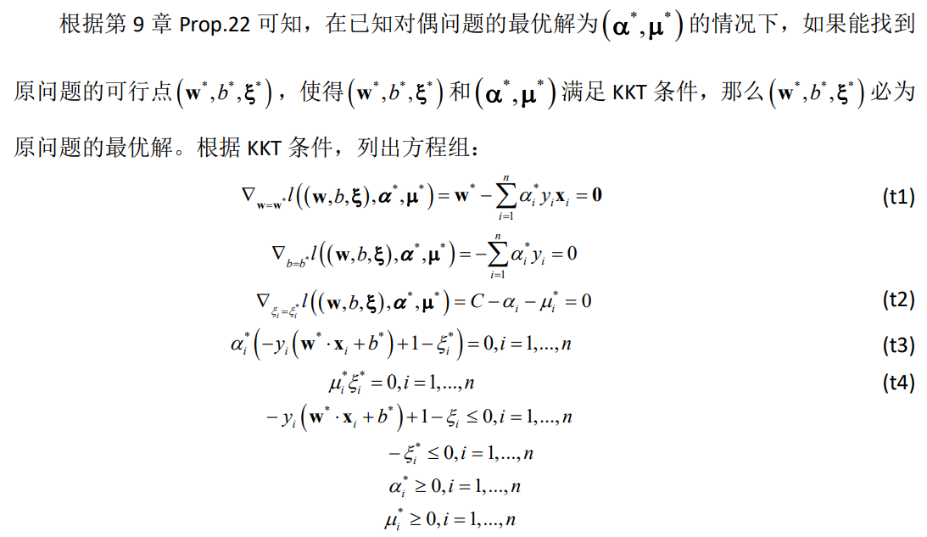
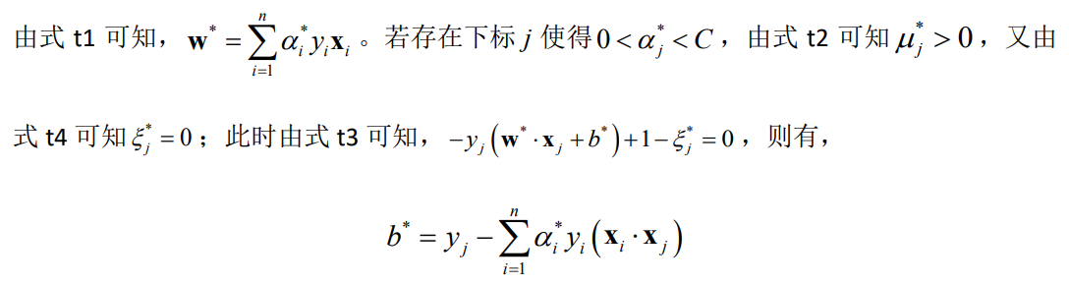
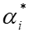
Soft-margin SVM solver based on duality
Second, with , based on KKT conditions, derive the primal optimal solution
Proposition 4: Suppose that is the optimal solution for Eq. 9. If there exists an j, making , then, (w*, b*) can be computed as,
(Eq. 11)
(Eq. 12)

Slide 44
Soft-margin SVM solver based on duality
Second, with , based on KKT conditions, derive the primal optimal solution
Proposition 4: Suppose that is the optimal solution for Eq. 9. If there exists an j, making , then, (w*, b*) can be computed as,
(Eq. 11)
(Eq. 12)
With the optimal separating hyperplane (w*, b*), the classification decision function can be,

Slide 45
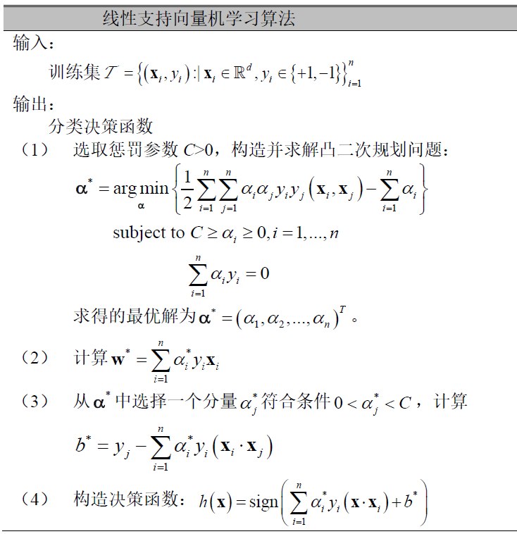
Soft-margin SVM

Slide 46
Soft-margin SVM
Example:
The training sample (x_{i}, y_{i}) corresponding to is the support vector and it must satisfy

Slide 47
Outline
Linear separability and hyperplanes
The perceptron learning algorithm
Hard-margin SVM
Soft-margin SVM
Kernelized SVM
Multi-class classification with SVM
Object detection using SVM+HoG

Slide 48
For nonlinear classification: Mapping from low dimensional space to a high dimensional one
When the dataset is linearly separable or nearly linearly separable, linear SVM (soft-margin SVM) can work well
However, when the dataset is not nearly linearly separable, the performance of linear SVM will be poor
Consider a dataset of 2D points as the right figure. You cannot find a proper “separating line” that can separate the two classes of data
However, a dataset being not linearly separable in its original space does not necessary mean that it is not linearly separable when being mapped to another high-dimensional space!

Slide 49
For nonlinear classification: Mapping from low dimensional space to a high dimensional one
For example, using the following mapping ,
The mapped data in the high-dimensional space is now linearly separable!

Slide 50
For nonlinear classification: Mapping from low dimensional space to a high dimensional one
From this example, we can formulate a general idea to solve non-linear classification problems with SVM:
Training stage
Given a training dataset which is not linearly separable
Determine a mapping function
For each x_{i}, map it as into a high-dimensional feature space
In , train a linear SVM model using as the training data
Testing stage
Given a test sample t, which is expressed in the original low-dimensional space
Map t into as
Classify using
How to determine for a given dataset does not have a fixed correct answer, and it may depend on experience!

Slide 51
For nonlinear classification: Mapping from low dimensional space to a high dimensional one
Linear SVM:
Linear SVM in high-dimensional space :
When data is not linearly separable,
mapping data into
by using
The classification decision function,
The classification decision function,
where
where
Using , mapping data points to
Computing the dot product between two mapped points
Is there a function that can implicitly return the dot product of two points in the high-dimensional space?
That is the kernel function!

Slide 52
Kernel function
Definition 6: Kernel function. Suppose that is the original low-dimensional feature space and is the high-dimensional feature space. If there exists a mapping,
, the function satisfies that,
Then, the function is called the kernel function
With the kernel function, we do not need to explicitly define the mapping function and the high-dimensional space!

Slide 53
Kernel function
It needs to be noted that for a given kernel function K, the associated high-dimensional space and the mapping function are not unique
Example.
Suppose the original feature space is . The kernel function is
can be and can be
can be and can be
can be and can be

Slide 54
Kernel function
Commonly used kernel functions in the field of SVM
Polynomial kernel function:
Gaussian kernel function (radial basis function, RBF):

Slide 55
Kernelized SVM
Linear SVM in high-dimensional space :
Kernelized SVM:
with the kernel function K
The classification decision function,
The classification decision function,
where
where
When the mapping function implicitly represented by the kernel function is nonlinear, the kernelized SVM is a nonlinear model and is called nonlinear SVM

Slide 56
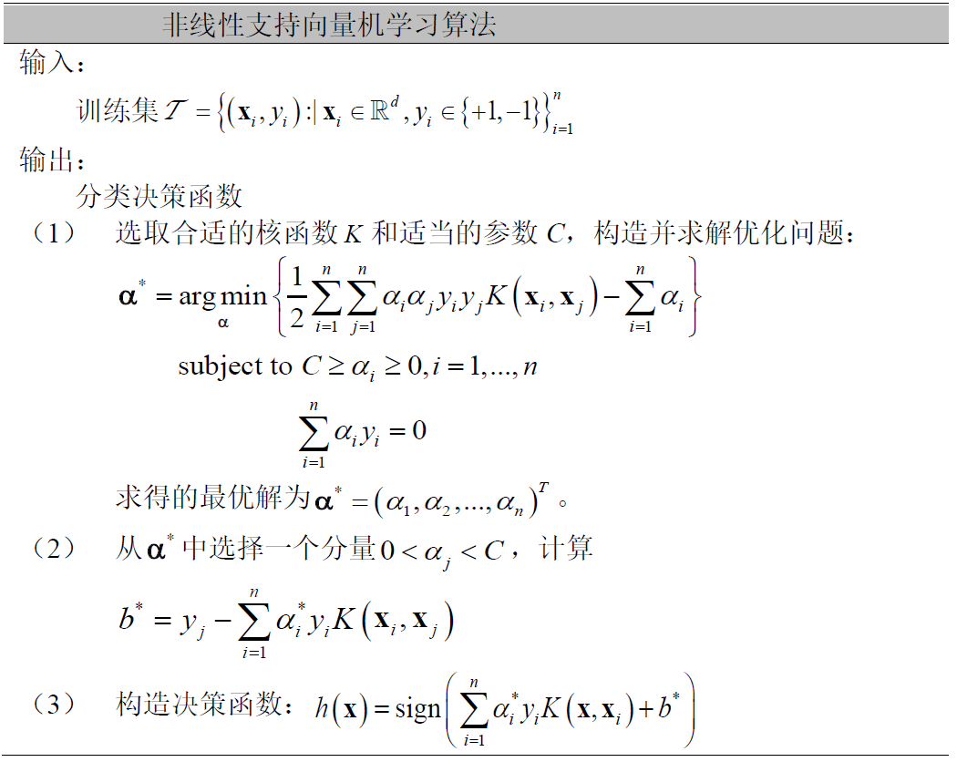
Nonlinear SVM

Slide 57
Nonlinear SVM
Example:
A nonlinear classification problem
The curve is the decision boundary obtained by using nonlinear SVM

Slide 58
Outline
Linear separability and hyperplanes
The perceptron learning algorithm
Hard-margin SVM
Soft-margin SVM
Kernelized SVM
Multi-class classification with SVM
Object detection using SVM+HoG

Slide 59
From binary classification to multi-class classification
The previously mentioned SVM models are all designed for binary classification
With proper extensions, binary classification models (not limited to SVM) can be adapted to solve the multi-class classification problems
Two commonly used strategies to extend a binary classification model to a multi-class classification model, the one-versus-all approach and the one-versus-one approach

Slide 60
One-versus-all
Suppose that we are solving a K-class classification task
Training stage
We need to train K binary classifiers
When training h_{k} (represented by the hyperplane (w_{k}, b_{k})), taking training samples belonging to kth-class as the positive training samples, and all the other ones as negative training samples
Testing stage
Given a test sample t
Compute t’s classification response with respect to all the K classifiers
t’s label =

Slide 61
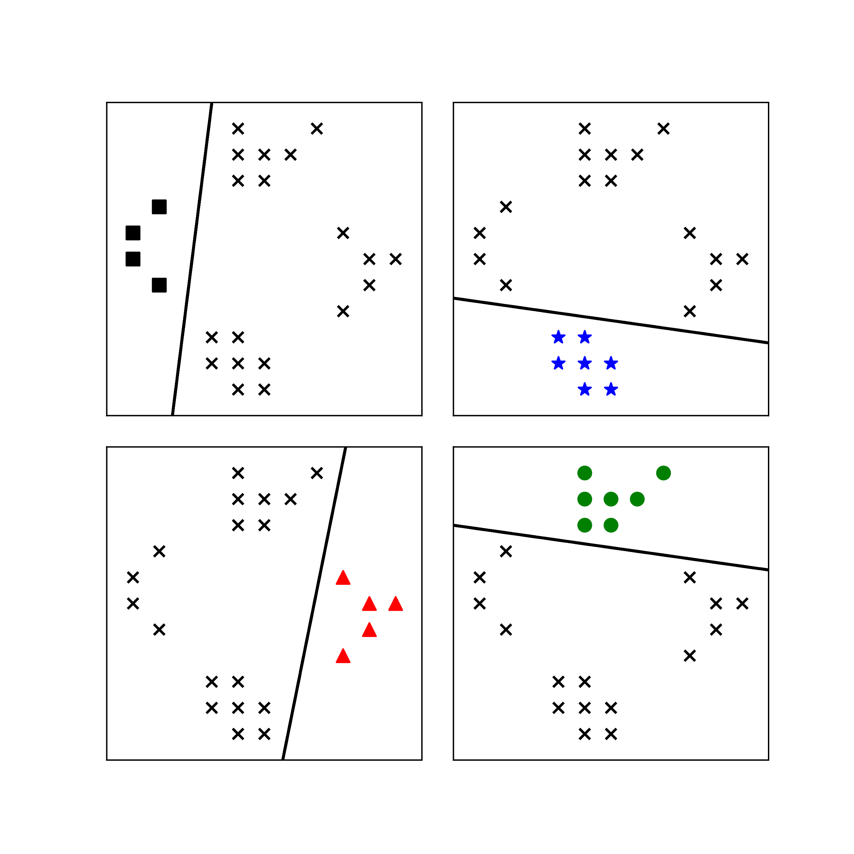
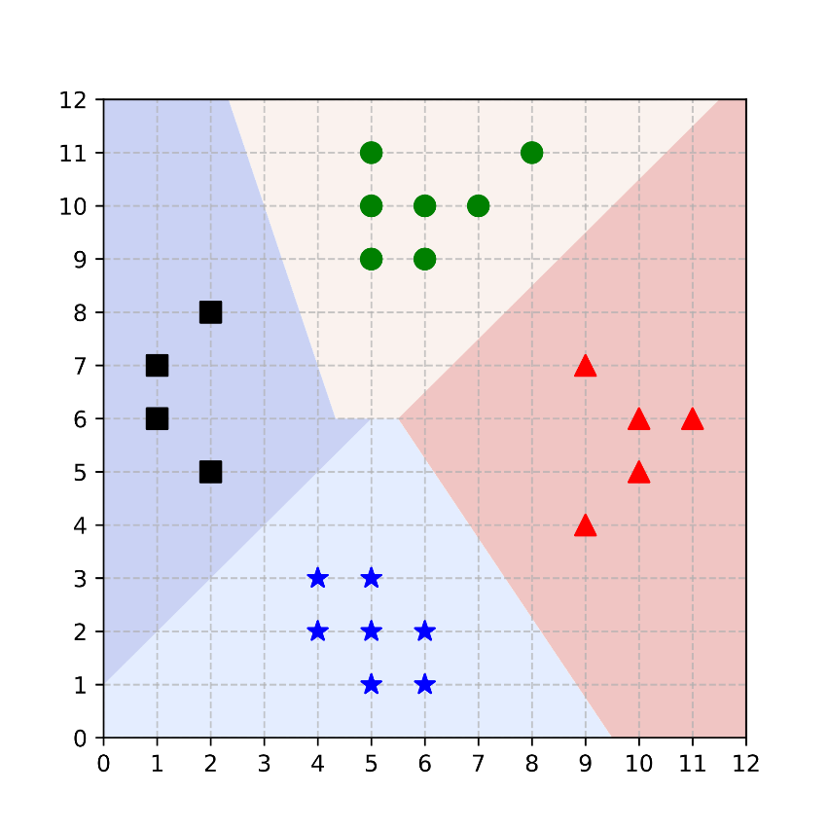
One-versus-all: A toy example
Decision boundaries for the 4 classes
A 4-class classification problem
train 4 binary classifiers

Slide 62
One-versus-one
Suppose that we are solving a K-class classification task
Training stage
For each pair of two classes, i and j, , train a binary classifier
Altogether, we can have binary classifiers
Testing stage
Given a test sample t
Classify t using all the K(K-1)/2 binary classifiers and we can get K(K-1)/2 results,
Using the “voting” strategy to get the final label of t,
t’s label = The element with the most occurrences in C

Slide 63
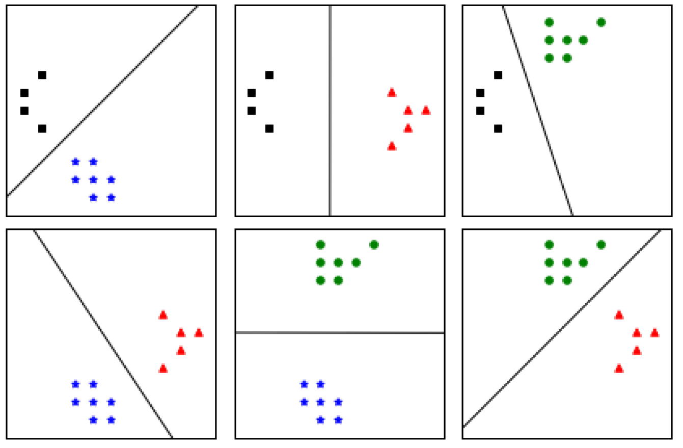
One-versus-one: A toy example
A 4-class classification problem
train 6 binary classifiers

Slide 64
Outline
Linear separability and hyperplanes
The perceptron learning algorithm
Hard-margin SVM
Soft-margin SVM
Kernelized SVM
Multi-class classification with SVM
Object detection using SVM+HoG

Slide 65
Object detection using SVM + HoG
Here’s a brief overview of the basic process for object detection using SVM and HoG features:
Data Preparation: Collect and label a dataset with positive (containing the target object) and negative (background) samples
HoG Feature Extraction: Compute HoG (Histogram of Oriented Gradients) features for each image in the dataset; HoG captures gradient information, which is effective for object detection
Training the SVM: Use the extracted HoG features to train a Support Vector Machine (SVM) classifier; The SVM learns to distinguish between positive and negative samples
Sliding Window Detection: Apply a sliding window approach to new images; Extract HoG features from each window and use the trained SVM to classify whether the window contains the target object
Non-Maximum Suppression (NMS): To eliminate redundant detections, apply NMS, which keeps the most confident detection and suppresses overlapping ones

Slide 66
Object detection using SVM + HoG
Histogram of Oriented Gradients (HoG) is a feature descriptor widely used in computer vision for object detection and recognition tasks. It captures the distribution of gradient orientations in an image.
Gradient Computation: The first step is to compute the gradients of the image, typically using filters like Sobel or Prewitt
Cell Division: The image is divided into small spatial regions called cells (e.g., 8x8 pixels)
Orientation Binning: Within each cell, gradient orientations are quantized into a fixed number of bins (e.g., 9 bins covering 0°to 180°). The gradient magnitudes are accumulated into these bins to form a histogram, representing the dominant edge directions in the cell.
Block Normalization: Cells are grouped into larger regions called blocks (e.g., 2x2 cells). To improve robustness to lighting variations, the histograms within a block are normalized using methods like L2-Norm or L1-Norm
Feature Vector Formation: The normalized histograms from all blocks are concatenated into a single feature vector, which represents the HoG descriptor for the image or region

Slide 67
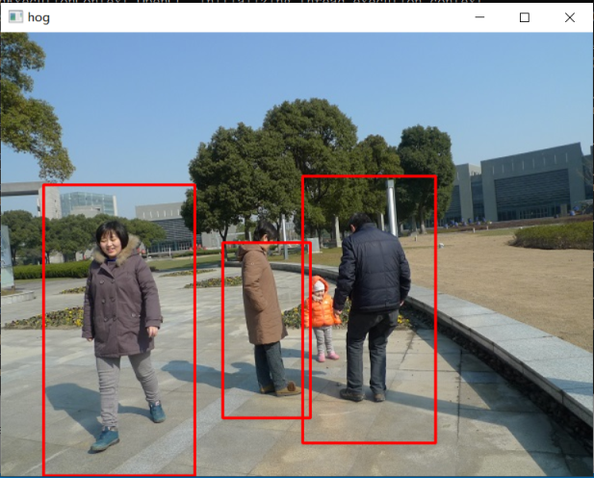
Object detection using SVM + HoG
SVM + HoG pedestrian detection result using OpenCV’s implementation

Slide 68


